Slide 1

Pseudo-Constants in SQL
@RileyMajor

Slide 2
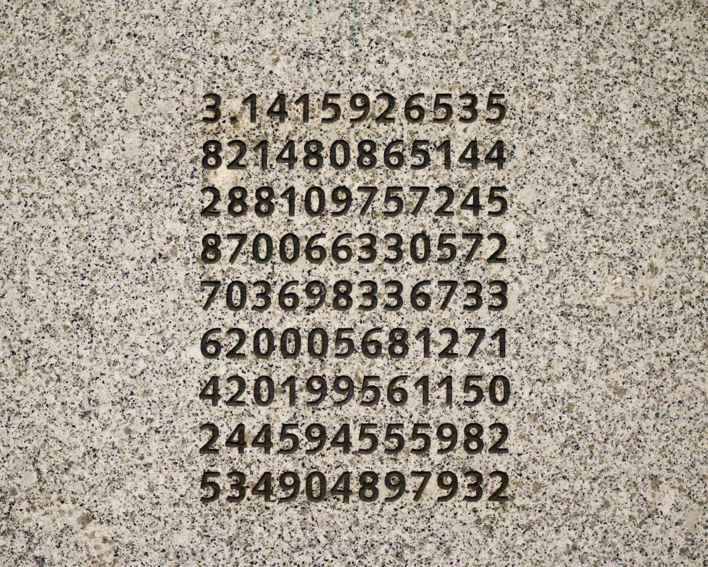
Pseudo-Constant Candidates
Infrequently Changed
Frequently Referenced
These digits are misleading.
http://en.wikipedia.org/wiki/Washington_Park_MAX_Station

Slide 3
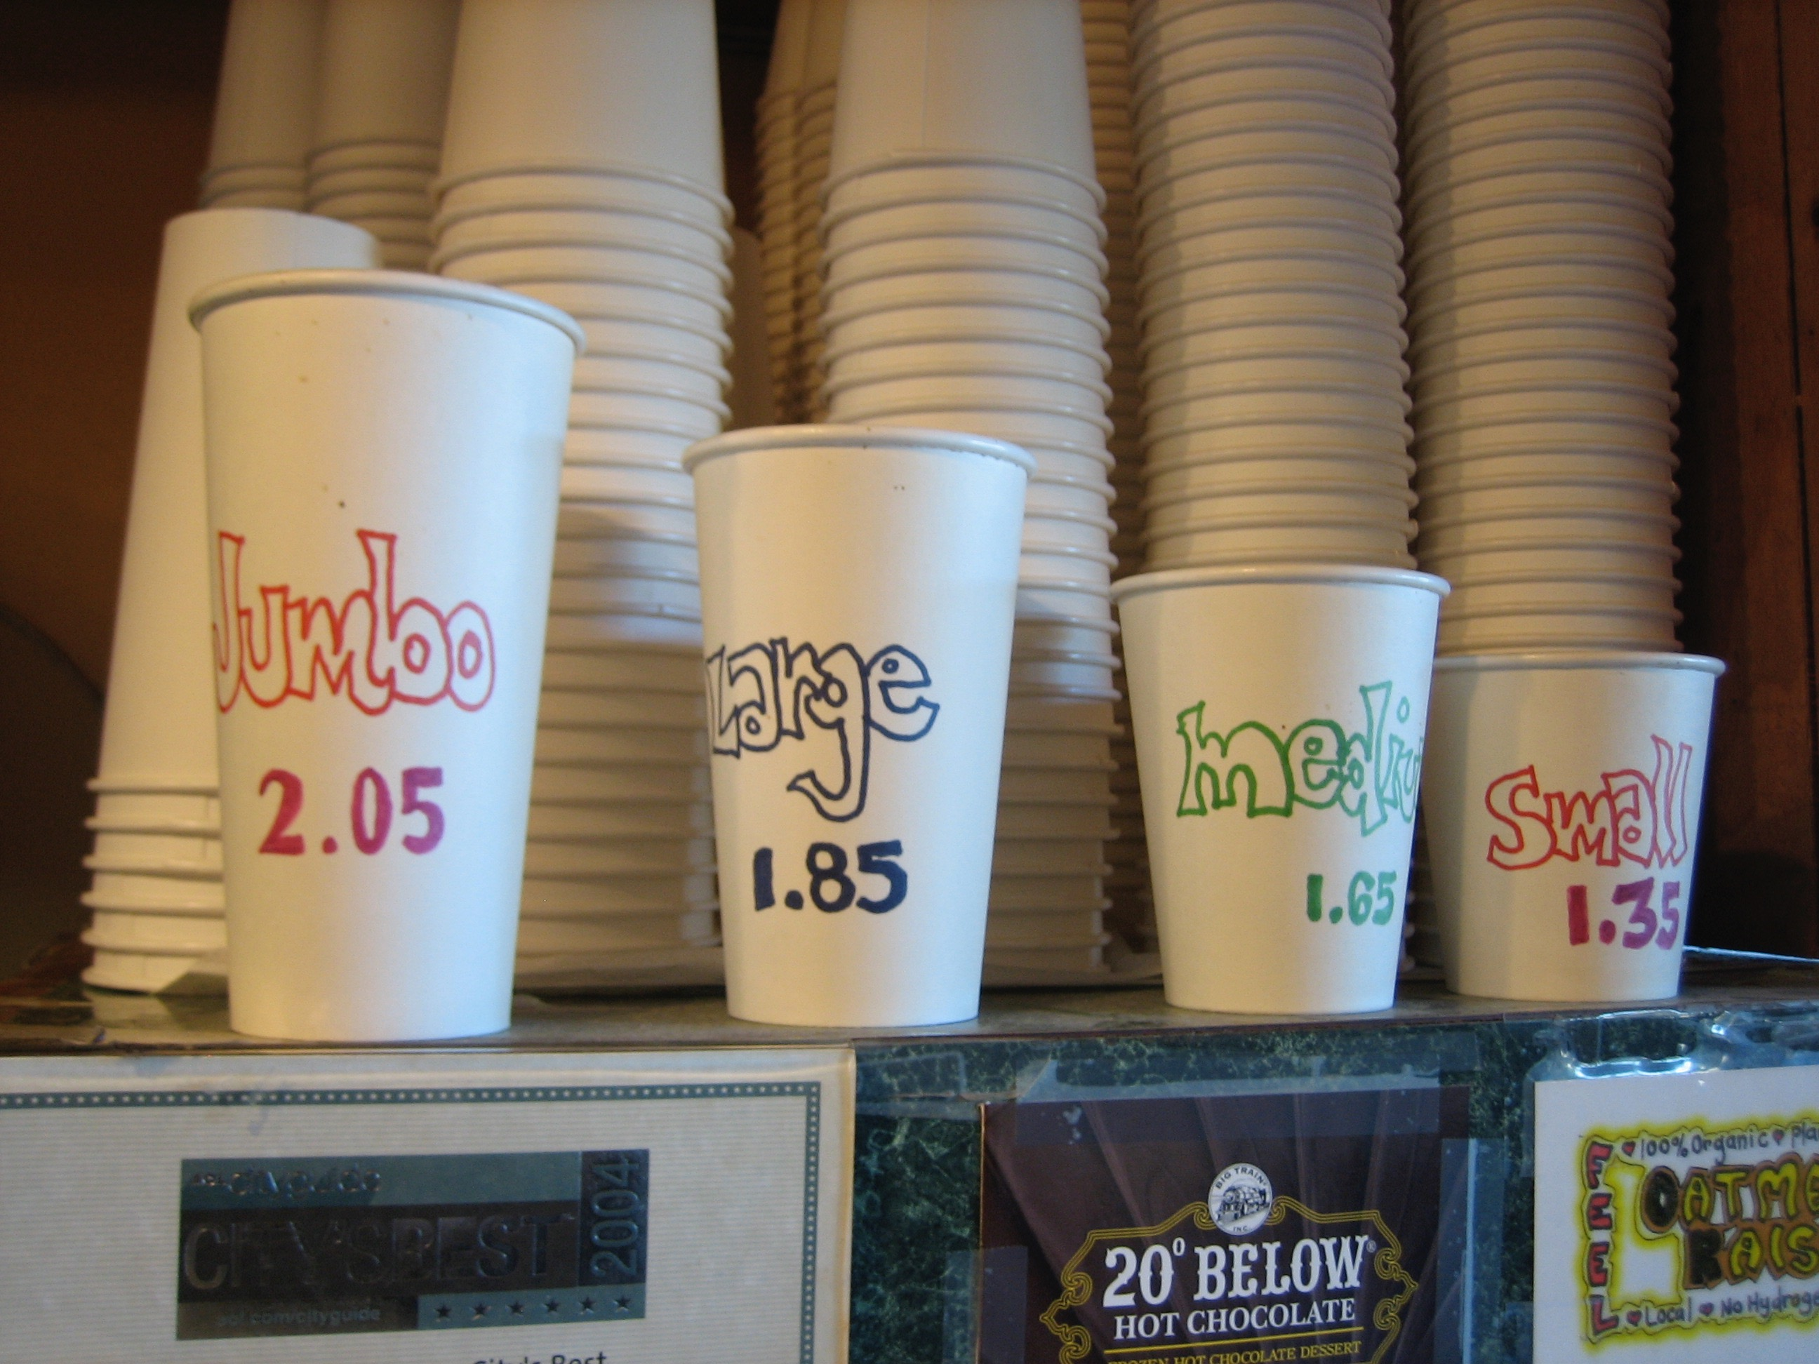
They’re everywhere…
Sizes
Order Statuses
DEFCON Levels
Notes:
Ask audience to come up with examples.
Reference Growing Pains episode where Mike worked at fast food restaurant with Colossal and “Woah” sizes.

Slide 4
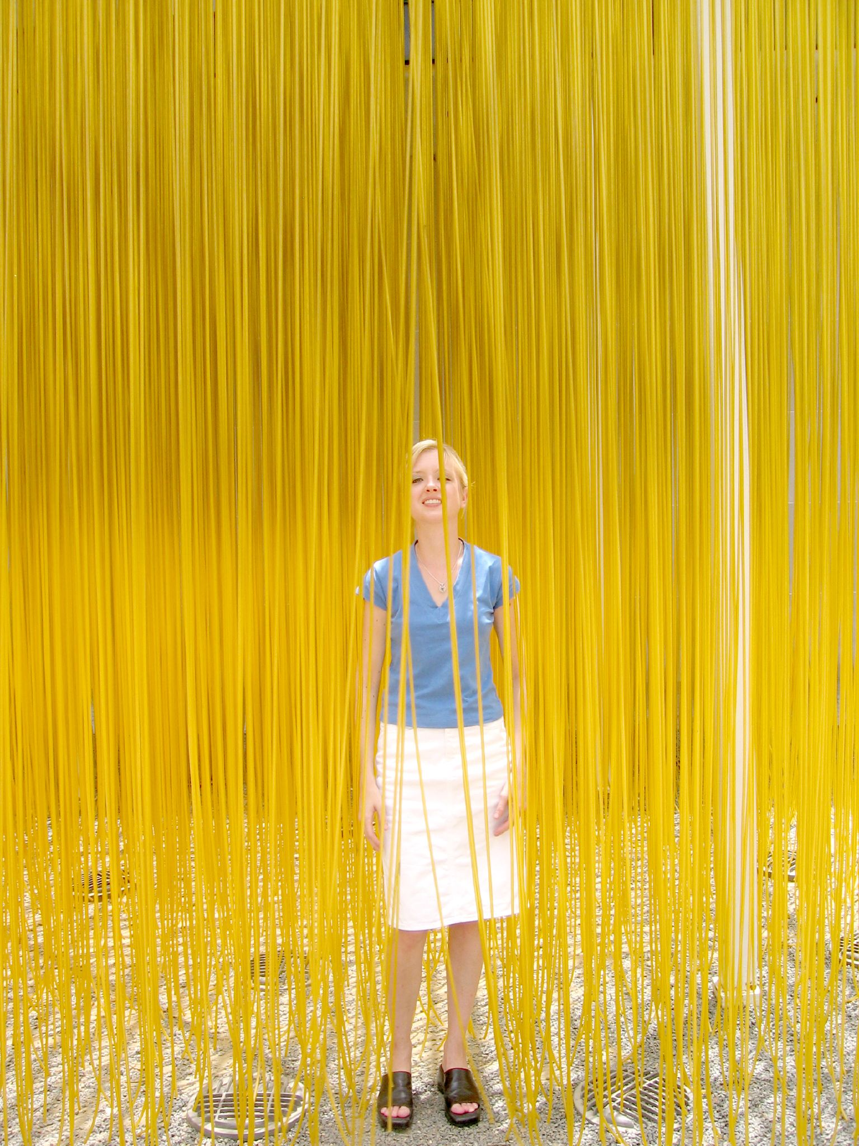
Whole mess o’ strings…
So much data.
Performance problems.
Consistency Issues.
Inflexible names.

Slide 5

Use Lookup Tables
Less Space
Better Performance
Cleaner Data
Numeric ID / Textual ID / Description

Slide 6

Magic
Numbers
Codes
Enums
Constants
IDs

Slide 7
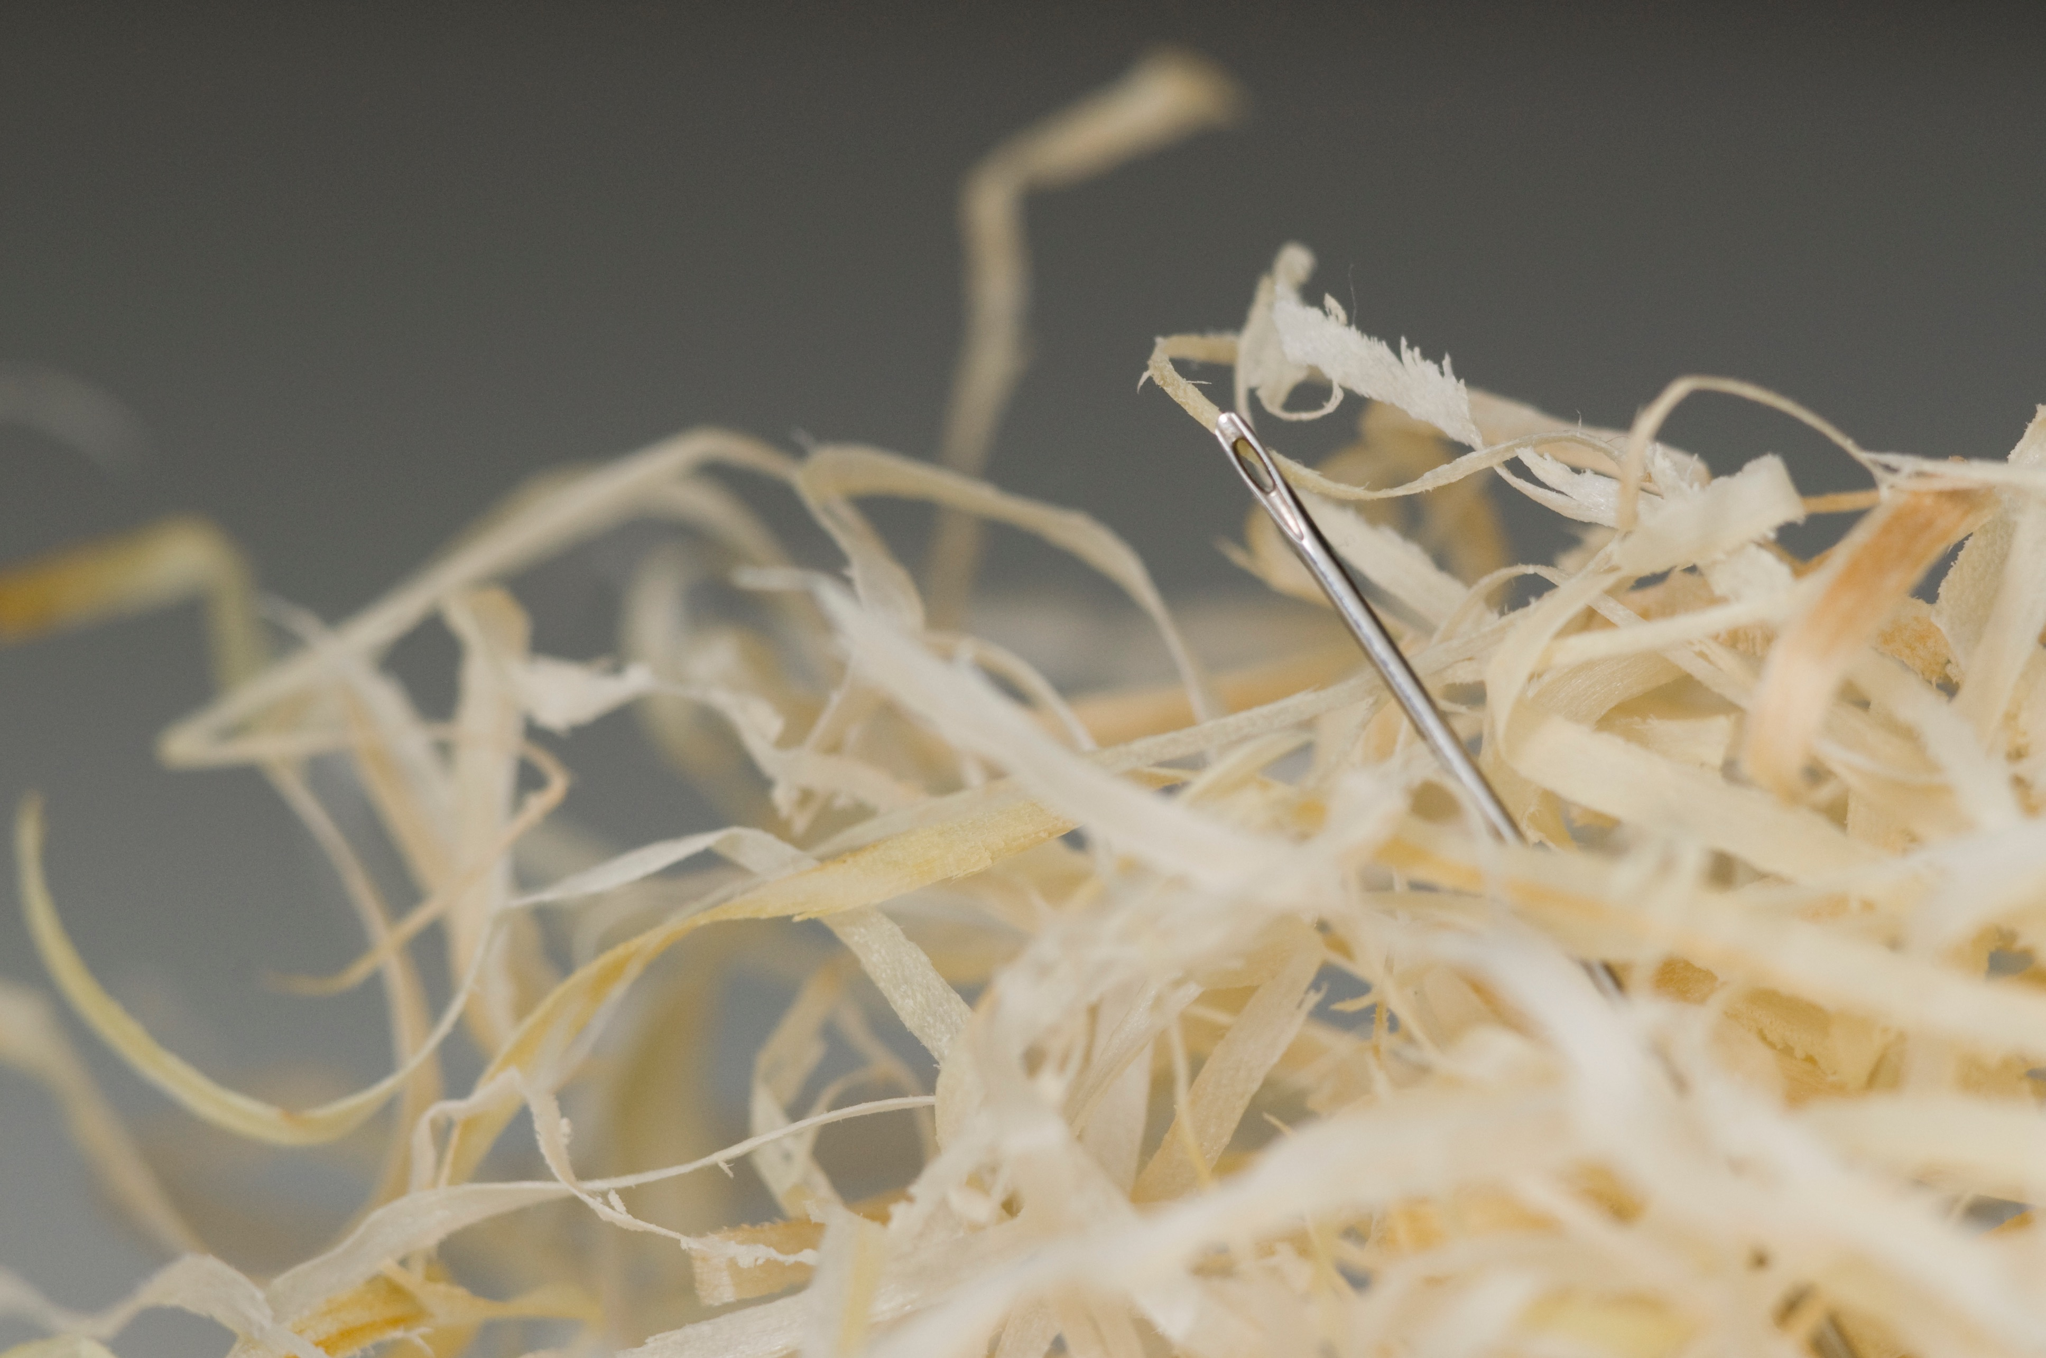
Traditional Option:
Hard Coding
Fast
Easy
Maintenance Nightmare
Did you find them all?

Slide 8
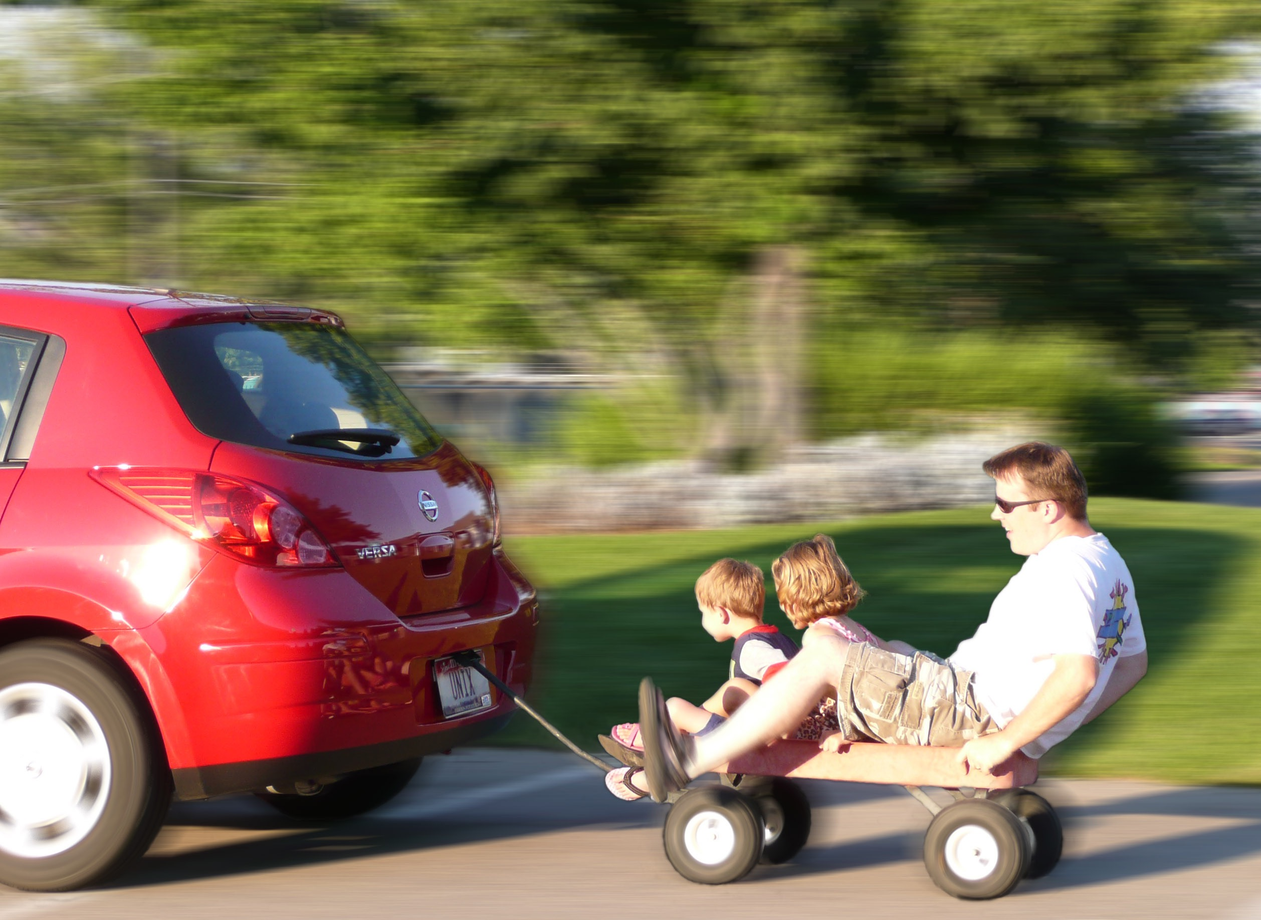
Better Option:
JOINs to Lookup Tables
Text Codes
Slightly Slower
More Complex Query Plans

Slide 9

Best Option:
Pseudo-Constant
Functions
Fast
Compiler Enforcement
IntelliSense

Slide 10
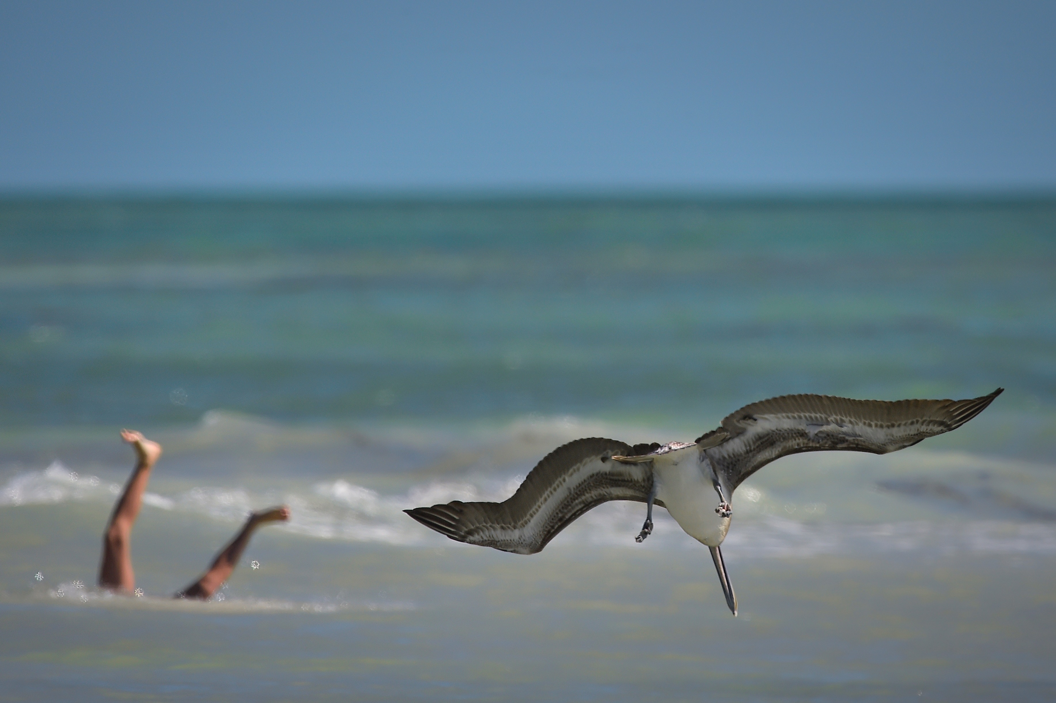
Let’s dive in…

Slide 11
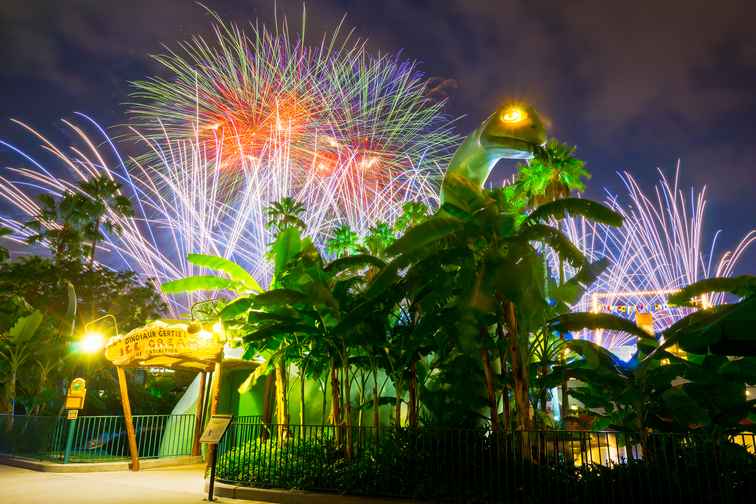
Pseudo-Constants
Inline Table-Valued User Defined Functions with a Column Per Value

Slide 12
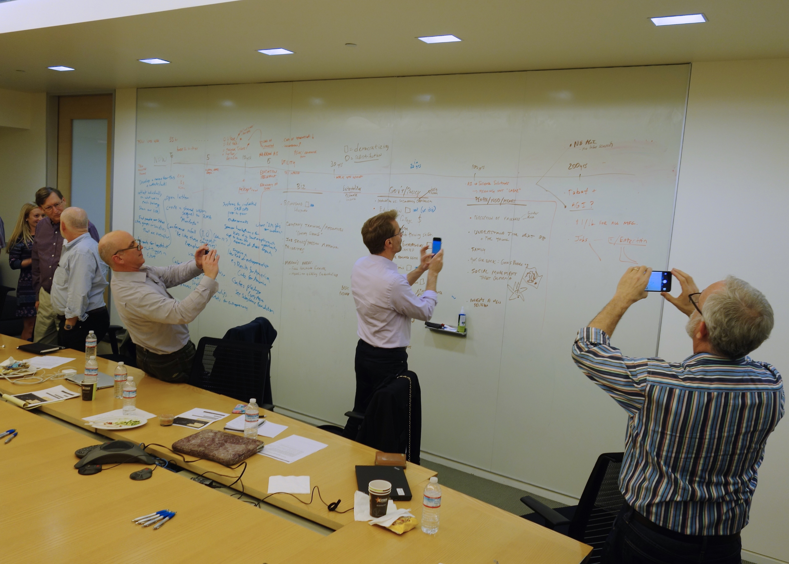
SELECT *
FROM dbo.CalcConstOrderStatuses() os
CROSS JOIN Orders AS o
WHERE o.OrderStatusID = os.OrderStatusAssigned;

Slide 13

Apply Liberally
Ad-Hoc SQL
Stored Procedures
Views
User-Defined Functions
Persisted Calculated Columns

Slide 14
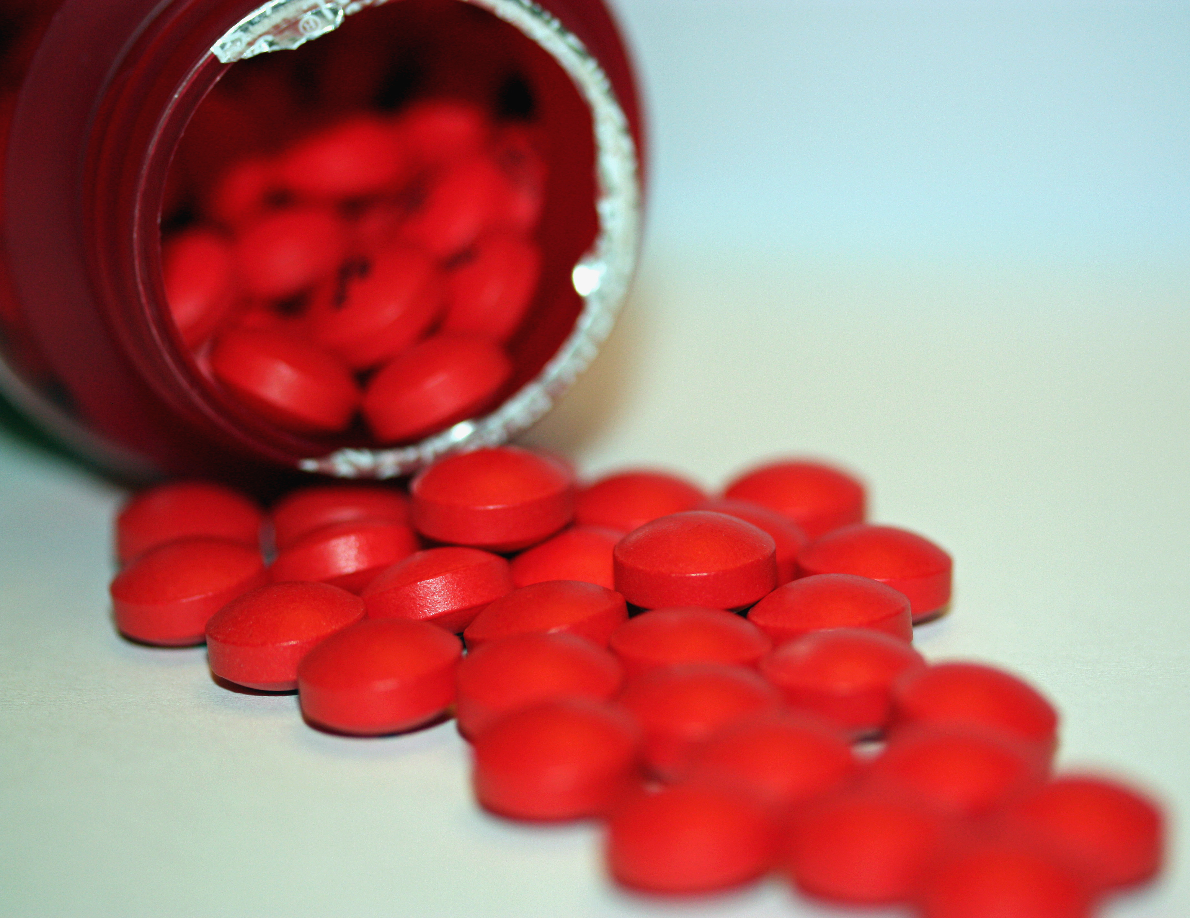
Do not take with…
Filtered Indexes
Indexed Views
OPTIMIZE FOR

Slide 15



Riley Wheeler Major
@RileyMajor
RileyMajor.com
PASSMN@RileyMajor.com
www.linkedin.com/in/rileymajor/
Enterprise Architect
Manna Freight Systems, Inc.
www.MFSCorporate.com
Director of Technology, PASSMN
mnssug.org

Slide 16
Photo Credits
Day 187: Tilt-Shift Miniature Fake
Snugg LePup
https://www.flickr.com/photos/snugglepup/3741073220
Pi
Benjamin Chan
https://www.flickr.com/photos/benchan/4771478057
IMG_8549
Tantek Çelik
https://www.flickr.com/photos/tantek/272706097
yellow strings
M Glasgow
https://www.flickr.com/photos/glasgows/117229470
The Worlds Greatest Detective
Kit
https://www.flickr.com/photos/practicalowl/1185217331
No more rabbits?
Kristina Alexanderson
https://www.flickr.com/photos/kalexanderson/6163134201
Needle In A Haystack
t_buchtele
https://www.flickr.com/photos/t_buchtele/3422507814
DSP 87: Wagon Ride 2007-08-12
Vern Hart
https://www.flickr.com/photos/vernhart/1143920492
Very excited for cake
Sean Donohue
https://www.flickr.com/photos/hermida/608166432
Everybody's Diving at the Beach
Diana Robinson
https://www.flickr.com/photos/dianasch/15963239265

Slide 17
Photo Credits (continued)
Hollywood Studios - Frozen Gertie
Jeff Krause
https://www.flickr.com/photos/jeffkrause/14730139972
Reflections on the new Machine Age — technology, inequality and the economy
Steve Jurvetson
https://www.flickr.com/photos/jurvetson/16620787618
apply liberally for best results
Ryan M. Follow
https://www.flickr.com/photos/vancityscapes/2499792217
pills
Dominique Godbout
https://www.flickr.com/photos/dominiquegodbout/5180502739

Slide 18
Additional References:
SQL Saturday Link:
http://www.sqlsaturday.com/387/Sessions/Details.aspx?sid=21735
Misleading Engraved Pi Digits
http://www.o4sr.org/publications/pf_v4n3/PiUnderground.htm
Wisconsin PASS Chapters:
FoxPASS - Appleton, WI
MADPASS - Madison, WI
Microsoft BI Professionals - Wisconsin: Greendale, WI
Western Wisconsin PASS - Altoona, WI
WI SSUG - Waukesha, WI

